Slide 1
Alpha
Insights
Data Science for
Business

Slide 2





Our Team
Gisela Medina
Martín Menéndez
CEO - Data Scientist
LDA - Lead Data Analyst
Mauro Cadme
CDO - Data Engineer
Damian Buch
Miguel Salas
CTO - Data Engineer
LDS - Lead Data Scientist

Slide 3

Our Company
We are an international consulting firm with presence in over 20 offices in Europe, America, and Asia. Specialized in data analysis and treatment, with extensive experience in the analytics area. We help our clients increase their profitability and develop their future competitiveness through the application of innovative technologies, we help maximize the value of data and improve decision making.

Slide 4
Our Presence

Slide 5
Mission
To be side-by-side with our clients, providing value solutions and technological services in their business, on a continuous basis.
Vision
We want to be a reference in our field and give to our clients a trusted and value-generating technological partnership in different business processes through our services and team of professionals, with a close, honest and reliable approach.
Values
We are pure digital DNA with a clear customer orientation and our competitive advantage arises from the set of ethical and professional principles of all the people who make up the organization.

Slide 6
Table of Contents
01
02
03
04
Project Goals
Why do we do it?
Scopes
What do we do?
Our Proposal
How do we do it?
Gantt Chart
When do we do it?

Slide 7
01
Project
Goals

Slide 8
Project Goals
Olist's goal is to achieve an annual growth in sales, the actions to be taken will be based on the results of the data analysis. To achieve this goal, the following objectives were proposed.
Increasing Olist's sales through:
The analysis of information that allows to reduce the average delivery time of orders to customers.
The providing strategic recommendations to sellers to increase their sales.
The expanding of the business model in Latin America.

Slide 9
02
Scopes

Slide 10
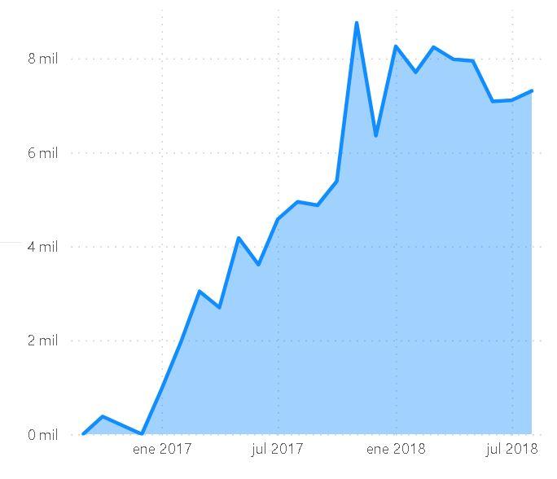
Deliver the data analysis with the following KPI
To improve CRR (Customer Retention Rate).
To Increase AOV (Average Order Value).
To reduce delivery times between Carrier and Seller (CSDT).
To improve CSAT (Customers Satisfactions) Score.
To increase Conversion Rate (CR).
To increase Olist penetrations in Latin America.
Prepare an automatic incremental load and a model execution for delivery of updated information
Development of Machine Learning models that allow
To evaluate sentiment analysis
To develop the strategic recommendations system for sellers
Total Sales
Notes:
To improve CRR (Customer Retention Rate) evaluating the rate of repeated purchases.
To Increase AOV (Average Order Value) applying related purchase recommendations.
To reduce delivery times between Carrier and Seller (CSDT) recommending the creation of logistics centers .
Improving CSAT (Customers Satisfactions) Score-Performing a sentiment analysis.
Increase Conversion Rate (CR).
To increase Olist penetrations in Latin America performing metrics related to the demographics and economy of each country.

Slide 11
03
Our
Proposal

Slide 12
Deliver information from a product recommendation system for suppliers.
Analysis of products with high rotation that allows offering the seller the Olist Logistics Center service.
Analysis of available Data that allows to enter new markets in Latin America.
Notes:
Deliver information from a product recommendation system for suppliers.
Establish a product recommendation system that also sold when the sale was made. Information will be taken from orders, based on the preferences or previous behaviors of users.
Analysis of available Data that allows to enter new markets in Latin America.
Through an analysis, it was detected that Mexico is the second country, after Brazil, with the greatest growth in e-commerce within the region (data published by AMVO).
Analysis of products with high rotation that allows offering the seller the Olist Logistics Center service
According to the metrics of different e-commerce, when delivery times decrease, it results in an average increase in sales of 63% (source AMAZON)

Slide 13
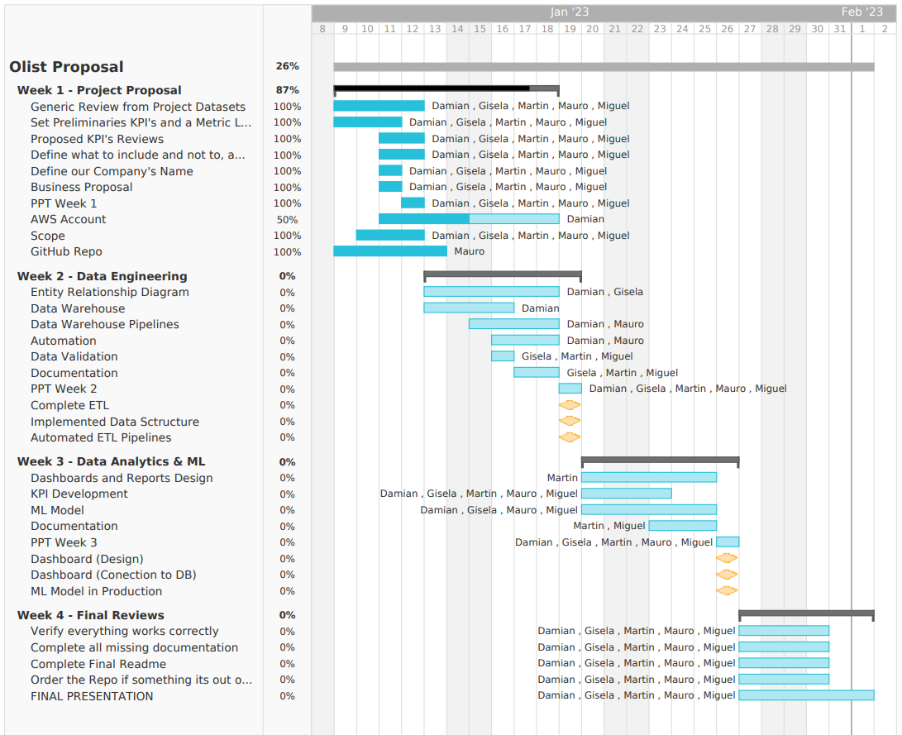

Slide 14
Technological Stack
We decided to go with the AWS service because it has these advantages over the rest:
Scalability
Security
Broader range of services
More mature ecosystem
The services that were decided to use from AWS are the following:
IAM (Identity and Access Management)
S3 (Simple Storage Service)
QuickSight
Glue
Lambda
Athena
Notes:
Technological Stack
Python to develop the EDA, Python was used along with its Pandas and Matplotlib libraries.
We decided to go with the AWS service because it has these advantages over the rest:
Scalability: AWS allows for easy scaling of resources according to the needs of the application, whether increasing or decreasing processing, storage and bandwidth capacity.
Security: AWS has a wide variety of security options and services, including authentication, compliance, data protection and policy enforcement.
Broader range of services: AWS offers more services than others which makes it more versatile and able to handle a wider range of workloads.
More mature ecosystem: AWS has been around longer than its competitors and as a result has a more mature ecosystem with more third-party tools and services available.
The services that were decided to use from AWS are the following:
IAM (Identity and Access Management) is an AWS service that allows administrators to control who has access to the resources of the AWS account and under what circumstances.
S3 (Simple Storage Service) is an AWS cloud storage service that allows to store and retrieve data through a standard web interface.
Glue is an AWS service that allows to create and manage a data catalog to facilitate data integration between different AWS services. Glue also provides an extraction, transformation, and loading (ETL) engine to help clean, transform and move data.
Lambda is an AWS service that allows users to run code without having to provision or manage servers. With Lambda, can create functions that are automatically triggered when an event occurs (such as a data upload to S3 or an HTTP request) and automatically scale according to demand.
Athena is an AWS service that allows SQL queries on data stored in S3 without having to provision or manage infrastructure. With Athena, can analyze data quickly and efficiently.
QuickSight is an AWS service that allows it to create and share data visualizations and reports quickly and easily.

Slide 15
Issues
The information provided by the company is from 5 years ago, we consider that
we would have greater assertiveness
in the models if they gave us
updated information, considering
that the Covid-19 pandemic
boosted e-commerce.

Slide 16
Thanks!
Do you have any questions?
contact@alphainsights.com
+54 11 4421 8384
alphainsights.com

